Slide 1
S. Sivagnanam
F. Garzon
S. Sakai
K. Lin
./Chaincode Unit Testing
./Blockchain-Enabled Secure Log Management
Open Science Chain, SDSC REHS 2023
Rohin Sood - 11th Grade, Del Norte High School

Slide 2



Open Science Chain (https://opensciencechain.org/)
Secured and decentralized blockchain infrastructure to support scientific data workflows & collaboration
Create a trustworthy ecosystem for researchers
Enables improved data integrity, provenance, and sharing
Funded by the NSF, grant number 2114202

Slide 3

Hyperledger Fabric (HLF) & Chaincode
Open-source blockchain platform
Distributed ledger
Immutable
Consensus
Identity management
Membership Service Provider (MSP)
Chaincode
Defines business logic of the network
Open Science Chain Employs HLF
Test network
Peer orgs
Orderer orgs
Testing prewritten chaincodes
Notes:
Distributed ledger: every participant has a copy of the state of the blockchain network, each block contains a list of valid and ordered transactions
Consensus: ensure all nodes agree on the order and validity of transactions
Identity management: Uniquely identifies and authenticates users, membership service provider is crucial to ID creation, validation, & control policies
Chaincode: logic that defines the business rules of the network, specificies how transactions are processed & updates the ledger state

Slide 4


Unit Testing
Validate the smallest testable parts of a software application
Ensures robustness & reliability
Valid & invalid input scenarios, error handling, & edge cases
My Contributions:
getTransientMap()
putUser()
getAPIUserIdFromTransient()
APIUserIdToUUID()
submittingIdentityHasOU()

Slide 5
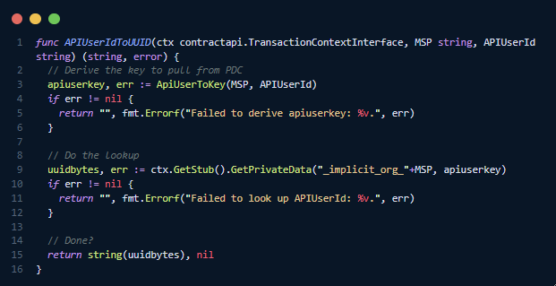
APIUserIDToUUID
Function Purpose:
Retrieve the UUID associated with an APIUserId by performing a Private Data Collection (PDC) lookup
Function Parameters:
TransactionContext (ctx), MSP name, the APIUserId
Function Output:
UUID as a string if found, or an error if the lookup fails

Slide 6
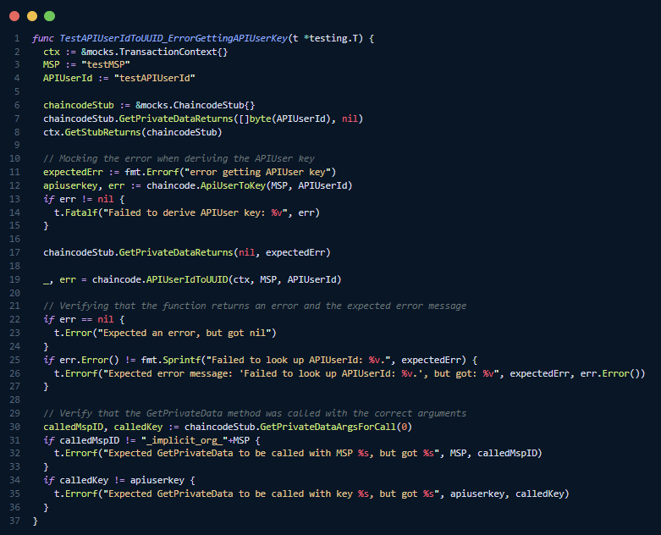
APIUserIDToUUID Test Case
Function Purpose:
Invoke the “Error Getting API user key” error
Mock objects and interfaces are used simulate blockchain interactions & isolate dependencies

Slide 7
Blockchain-Enabled Secure Log Management
Problem:
In the prominence of automation, data from logs are crucial to functionality and it can be difficult to assess if a log has been maliciously altered
Solution:
Blockchain ensures data integrity & security via immutability, decentralization, & transparency

Slide 8
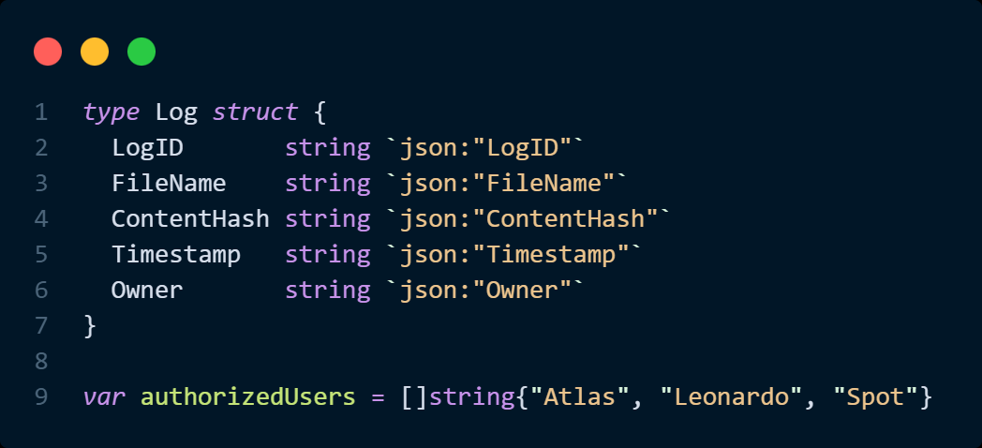
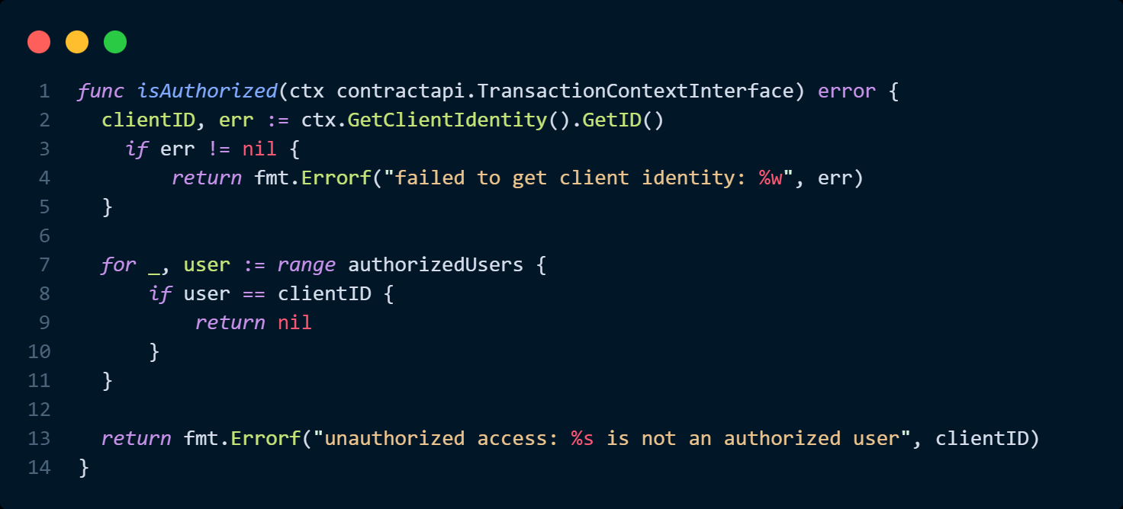
Proof-of-Concept Chaincode (https://github.com/rohinsood/roblockain)

Slide 9
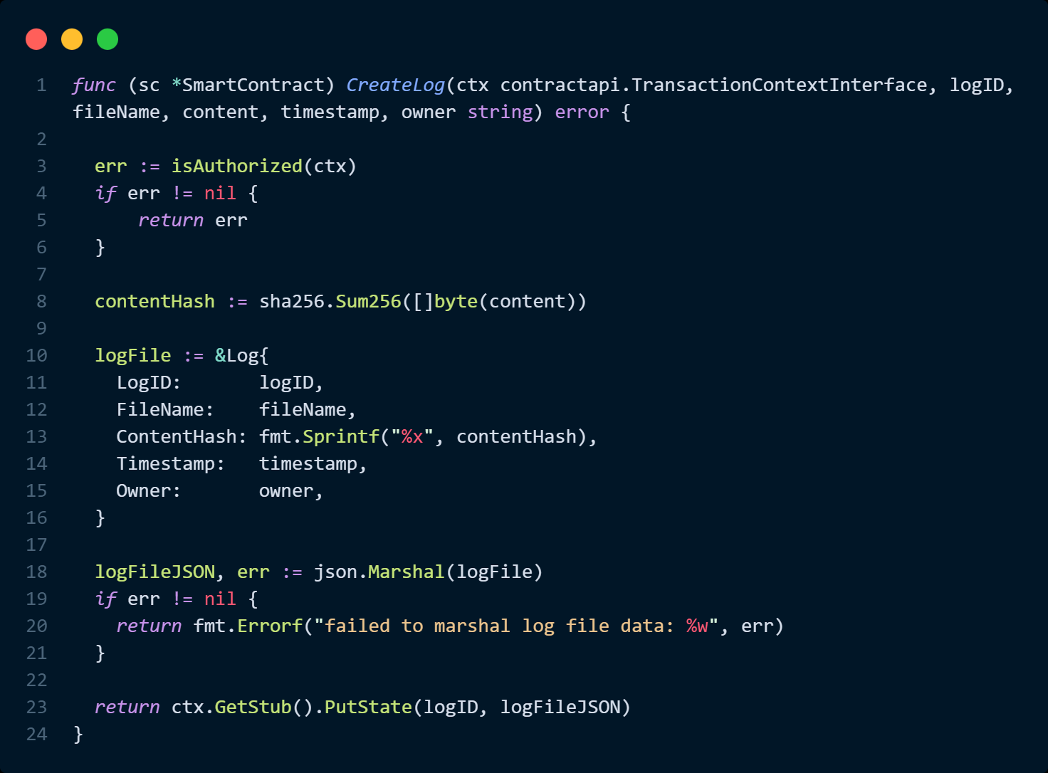
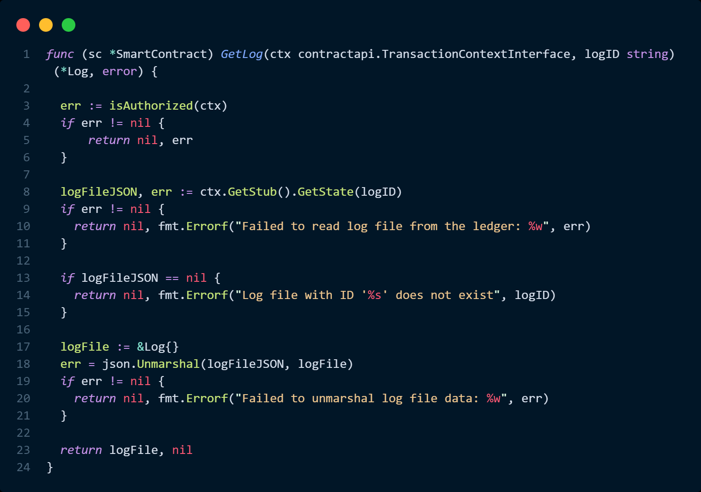
Proof-of-Concept Chaincode (https://github.com/rohinsood/roblockain)

Slide 10
Conclusion
Implemented
Next Steps
Test_network setup & use
OSC chaincode Unit Tests
Log file chaincode
Unit tests improve the software development process and lead to robust software in production
The use of blockchain in log management can be used to ensure data integrity
Chaincode unit testing
End to end testing
Gateway application development

Slide 11
Thank You

